Slide 1
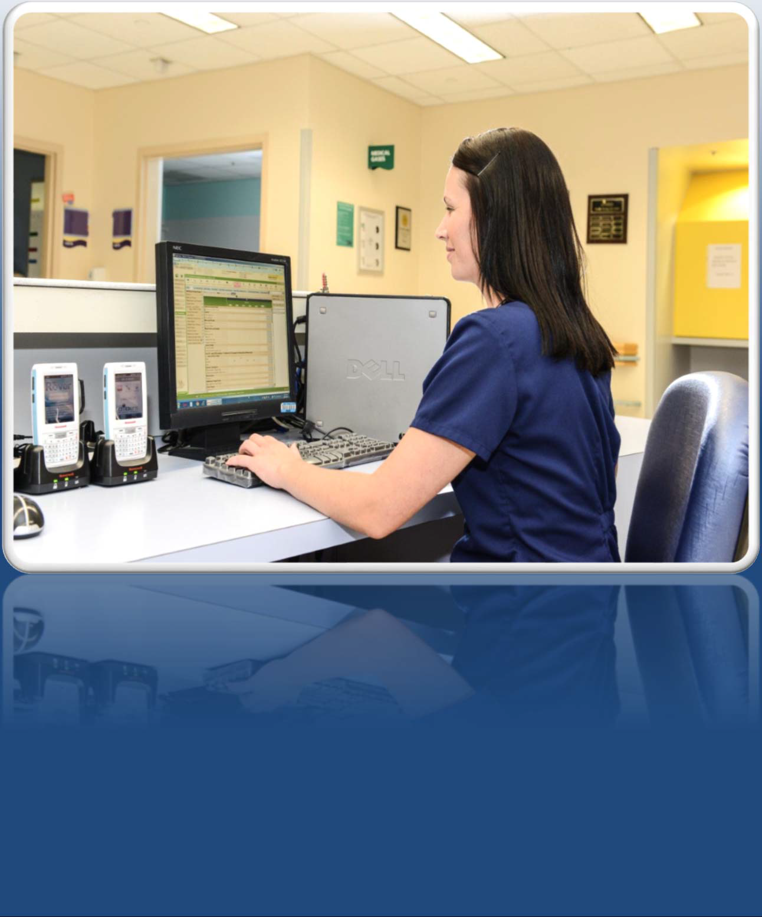

Epic for Nursing Students

Slide 2
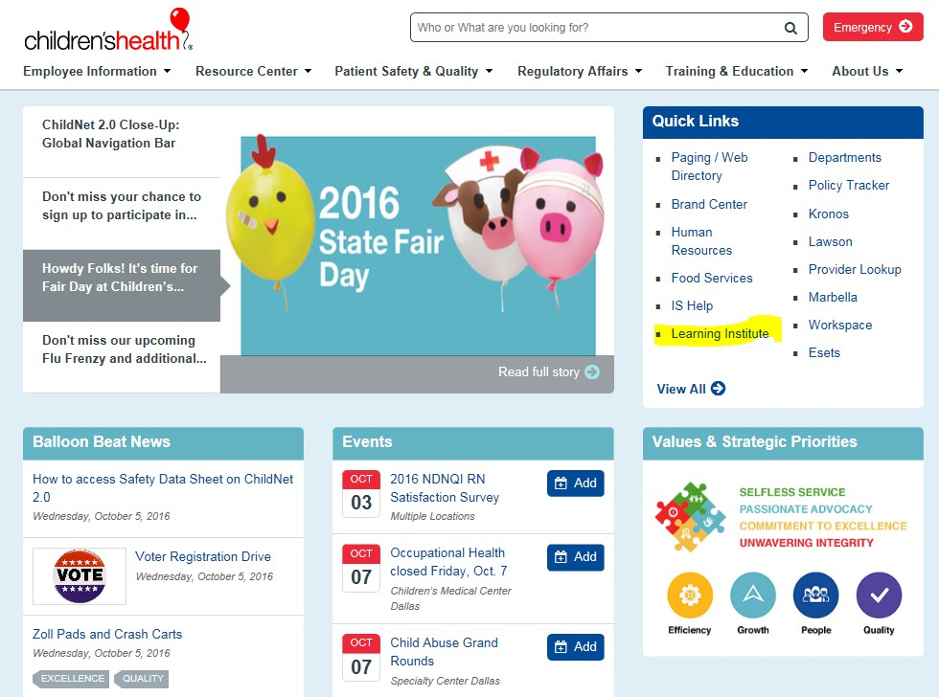

Finding Cornerstone
You should all be logged into a computer with your network login
Click on Internet Explorer
You will see Children's homepage (on right)
Click on Learning Institute

Slide 3
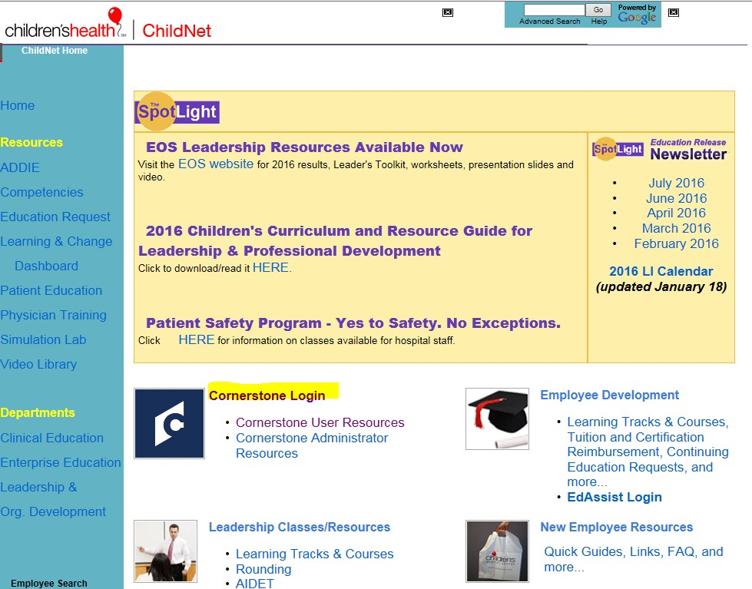

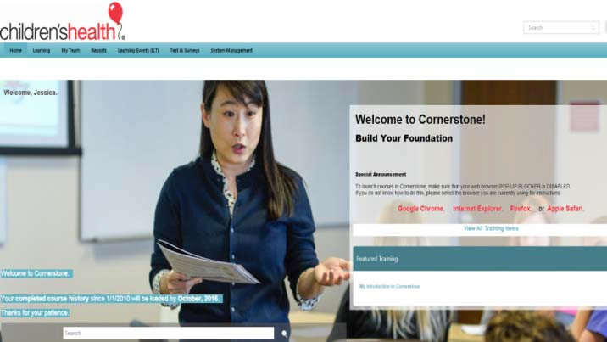
Logging Into Cornerstone
(Using Single Sign‐On)
Click on Cornerstone Login or Icon
You will be logged directly into Cornerstone

Slide 4
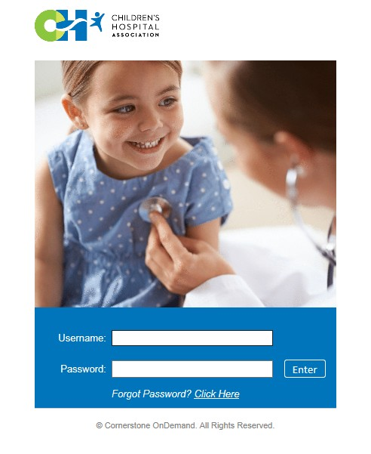

Logging into Cornerstone
(If Single Sign‐On Does Not Work)
If you get an error message you will need to type in https://childrenshealth. csod.com
You should be able to backspace until just the above is in the address box

Slide 5
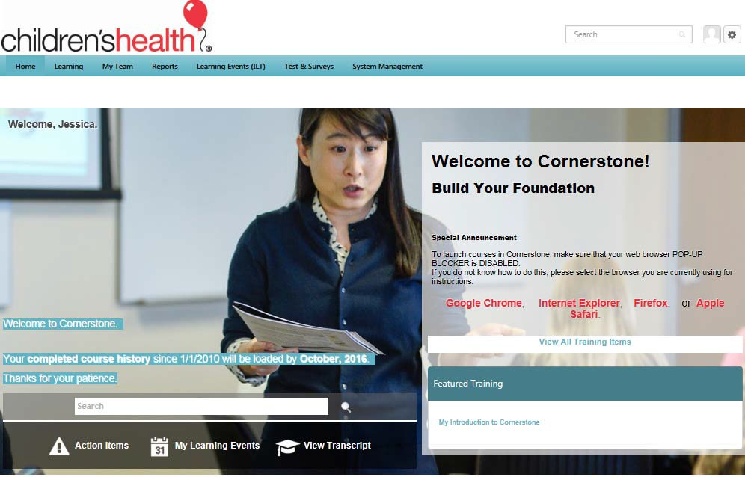
Username and Password for Cornerstone
(If Single Sign‐On Does Not Work)
https://childrenshealth.csod.com
Username: CMCDXXXXX
XXXXX= Your Employee ID number found on the page Access Management gave you this morning (no spaces)
Password: Success45
You will be required to change your password to something you will need to remember
Make sure you write this down in case you need it again

Slide 6
To Contact the Service Desk
If you need to contact the Service Desk during class or anytime during your rotation you will need to verify the following information:
  Date of Birth
  Last 4 Numbers of Your Social Security Number
  Your Employee Number/Lawson ID
    This number is on the sign in sheet for class and students should keep a record of this number

Slide 7

Tips for Training
Does your sound work?
– Ensure sound is on (found in bottom right corner)
– headphones for apple products do not work
– Use Closed Captioning if you want words and sound
If you experience freezing
  Give the computer a minute
  Reload section you were on
When all else fails logout and back in
  Should take you back to where you left off

Slide 8

Patient Safety Toolkit
You are part of the Children’s patient experience when you are campus so before you start on the modules, please review a few basics about AIDET, standardized handoff, and patient safety.

Slide 9
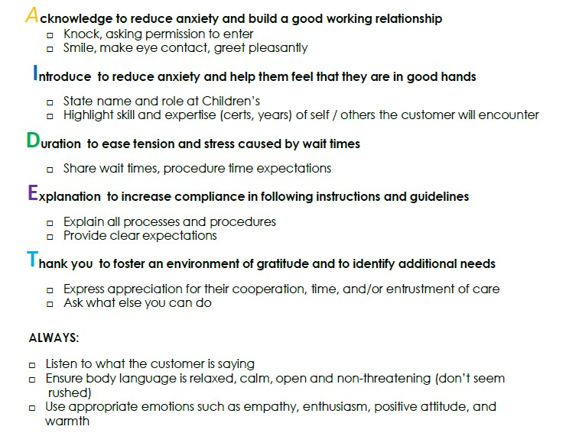
AIDET

Slide 10
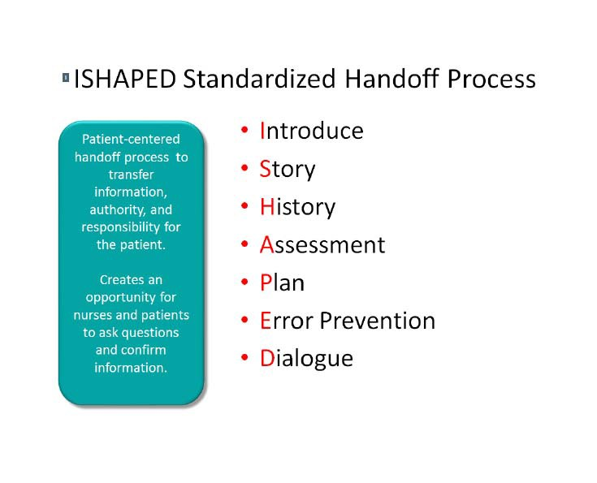
Standardized Handoff

Slide 11
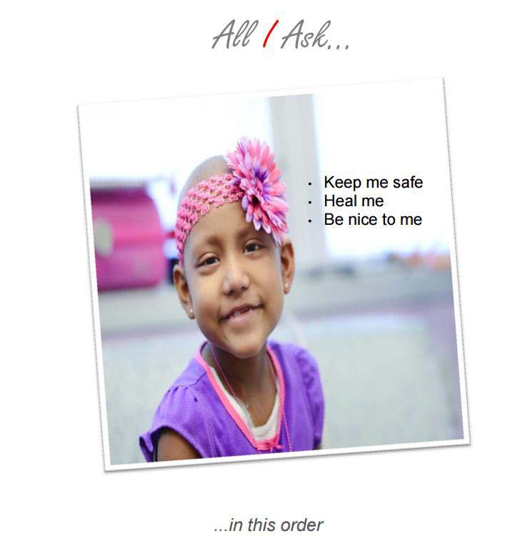
Yes to Safety. No Exceptions.
Keep Me Safe – care that is free from harm;
Heal Me – care that is effective in achieving best possible clinical results; and
Be Nice to Me – care that is delivered promptly and with compassion.
While on a Children’s campus, you can find more information about Yes to Safety. No Exceptions. at:
https://dallaschildrens.sharepoint.com/quality-patient-safety/Pages/Yes-to-Safety-Department.aspx

Slide 12
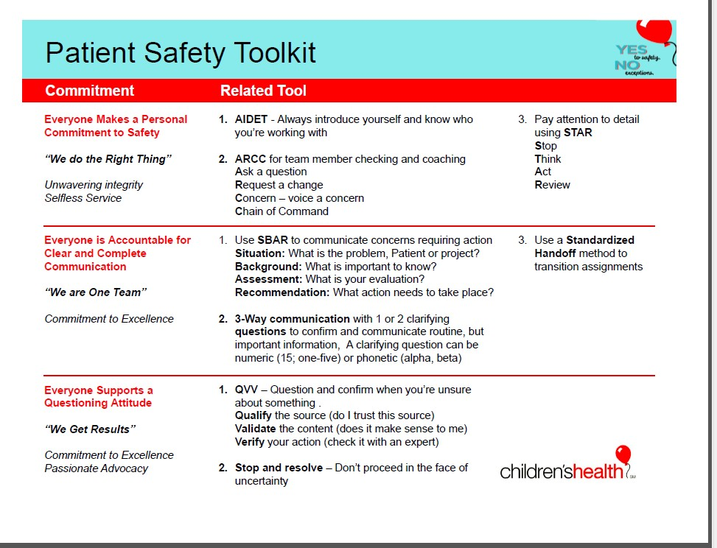
Summary of Patient Safety

Slide 13
Student Epic Course Objectives After completing this course you will be able to do the following:
Access patient records
Distinguish between Patient Summary and Chart Review Activities
View a list of active orders
Document patient information utilizing Doc Flow Sheets
Locate intake and output data
View a list of all medications
Review and document notes using the notes activity
Please NOTE: the current version of Epic that is in production at Children’s Health has a different color scheme

Slide 14
Student Epic Course
Please take NOTE of a few things before beginning the module:
The current version of Epic that is in production at Children’s Health has a different color scheme; functionality is all the same
You must LISTEN to the entire video or lesson as you go thru the CBT. If you fast forward or X out before the video is done, you will not receive credit for the module and will not be able to move forward in the curriculum
The production version of Epic arranges notes a little different than what is presented in the module. A nursing student should not be writing a note in the patient chart unless the nurse and instructor are consulted

Slide 15

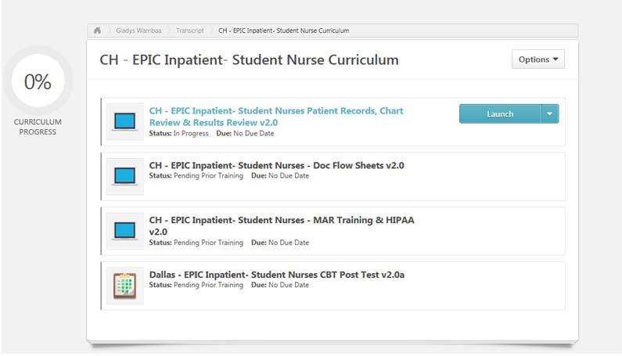
Completing Training in Cornerstone
At the bottom of the Screen you will click on View Transcript
You should have 1 curriculum in your assigned training
Click on the Launch button to start training
You will complete 3
modules and take test

Slide 16

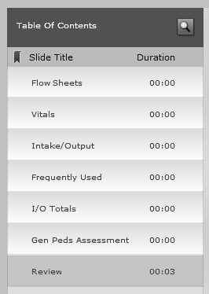
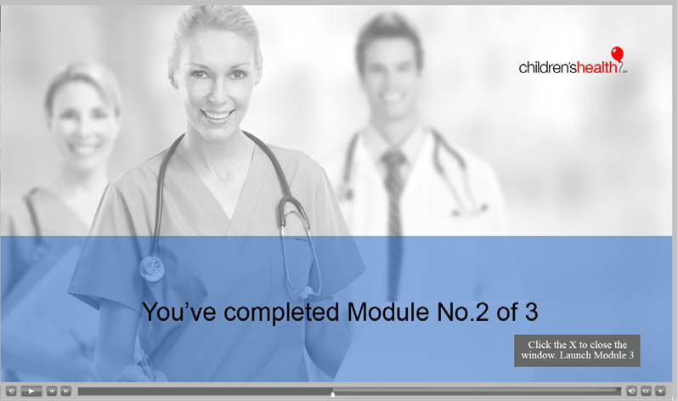
CBT Navigation
Pause
Back
Closed Captioning
CBT Requires Sound

Slide 17
HIPAA Attestation
By clicking the button below, I acknowledge that I understand the Information Privacy and Security Sanctions policy. I also acknowledge that I understand that my clinical rotation will be terminated if I access patient medical records without authorization.

Slide 18
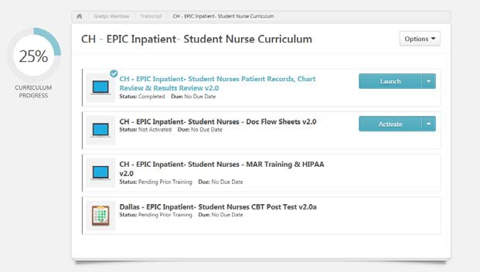
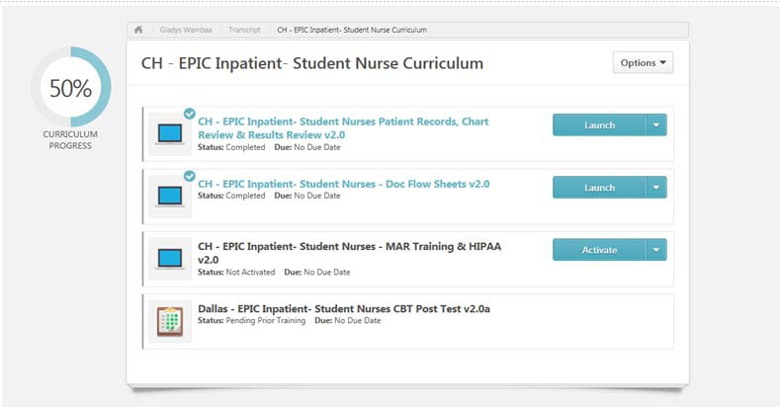
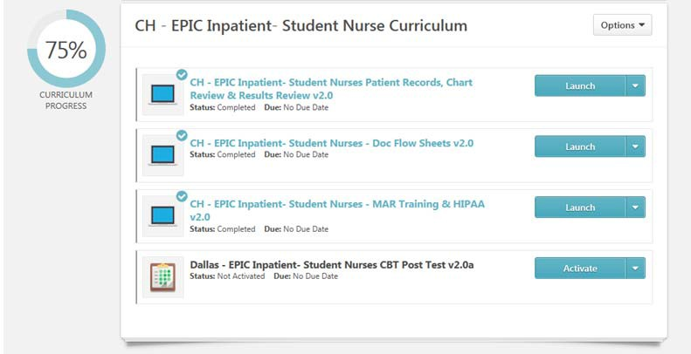
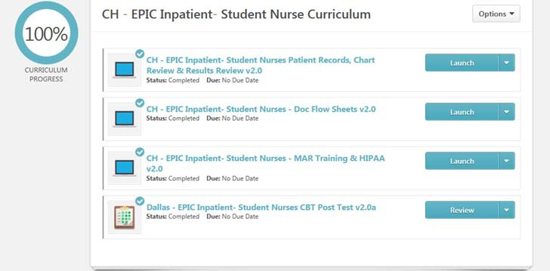
You will complete 3 modules, the evaluation, and then the test

Slide 19
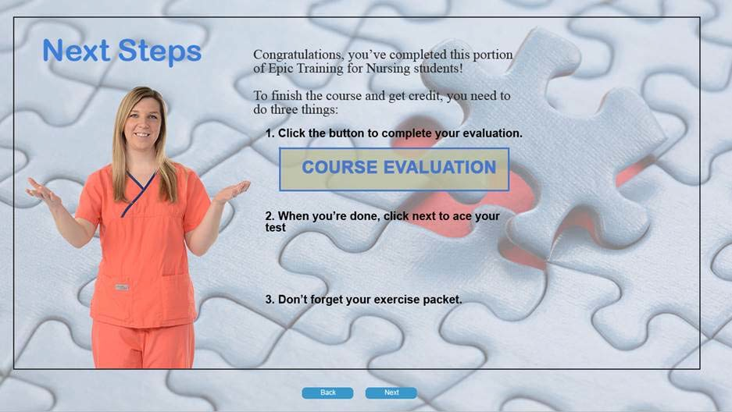
To Complete Evaluation

Slide 20
To Complete Evaluation
Dept. – Students
Division – Learning Institute
Position – (Name of School) student
Course – Epic Student Online Course (CBT)

Slide 21


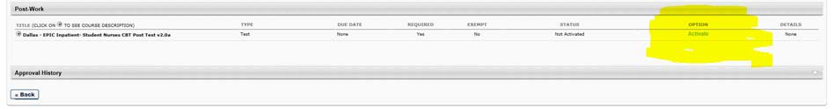
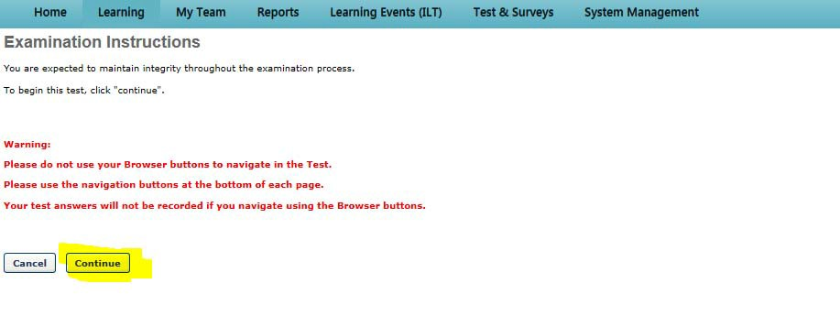
To complete Test follow the screens
Click on Post Work
Click on Activate
Click on Launch Test
4. Click on Continue
Now you are ready to take the test

Slide 22


How to Submit the Test
Once you have answered all of the questions and get to the bottom of the test you will see two boxes. Click on the Summary box
This will take you to a screen that shows you answered all of the questions. Click on Submit Final Answers

Slide 23
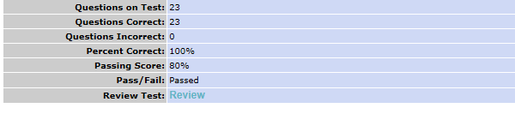
How to Review Your Answers
Once you click the Submit Final Answers button your test will be graded
80% or better is required to pass test
Stay on this screen to show instructor your test score
CLICK HERE TO REVIEW ANSWERS

Slide 24
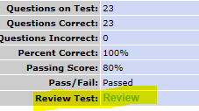

If You Don’t Pass Test on 1st Attempt
You can review answers if you need to by clicking on Review
If you want to see the questions you missed check the Show Details box when it brings up the Review Test Questions page
CLICK HERE TO SHOW DETAILS
You have 2 attempts to take test before you
have to be remediated

Slide 25
At the End of Class
Complete Evaluation and Test
Give instructor your test score
Wrap headphones and put them back in the box the way you found them
Log off your computer and clean up your area
Make sure you know how to log into the Epic playground to complete the Student Activity prior to starting your rotation
Enjoy your rotation!

