Slide 1

Student Rotations
Children’s Health
Children’s Medical Center
Pathology Department
Lab Education Department

Slide 2
Welcome
We would like to welcome you to Children’s Health. We hope you will enjoy your time with us and gain valuable knowledge and experience from our trainers and our staff.

Slide 3
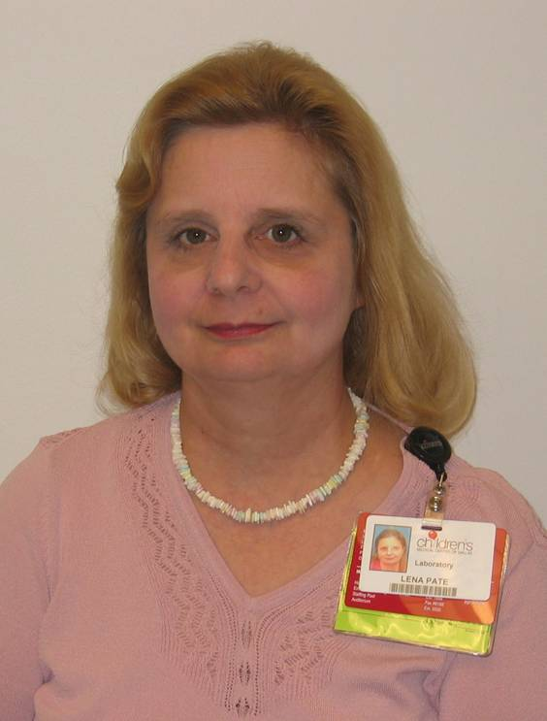
Lab Education staff
Lena M. Pate MT AHI (AMT)

Slide 4
Prior to Start date
We will need all the information filled in on the Student Request form,
  at least Three weeks prior to rotation,
  if you are going to have a rotation that lasts longer than one week
  or are rotating through Point of Care testing
You will also need to have:
  Completed the paperwork sent to you by Jessica Hagman
  Completed the CART in CHEX
  Read the Allied Health Handbook

Slide 5
First day meeting area and time
You will be expected arrive at 7:30. If you are late, please call to make other arrangements for meeting you.
The first day you will park in the open Visitors parking across from the Purple Parking garage. Security will give you a pass out of that parking once you acquire your badge. (See page 7 of the handbook).
Walk across the sky-bridge to the Main Hospital. Stop at the reception desk at the front reception desk of the D Tower.
Lena Pate from the Lab Education department will meet you at the desk.
You need to bring 2 forms of ID (one with a picture) to obtain a badge for the duration of your clinical rotation. Students must receive the badge prior to starting rotation. (See page 7 of the handbook).

Slide 6
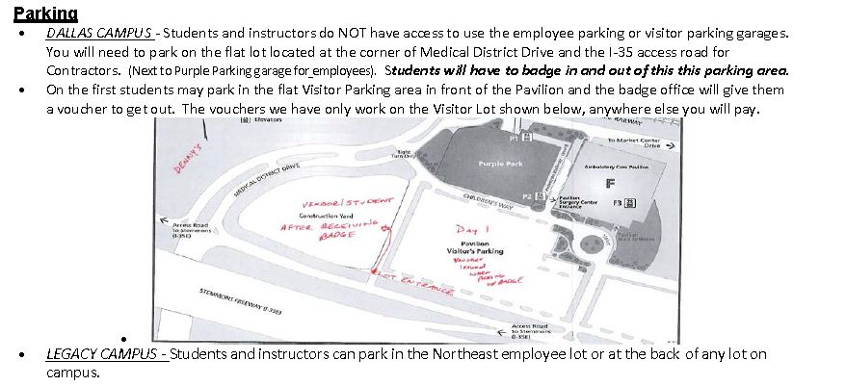
Student Parking

Slide 7
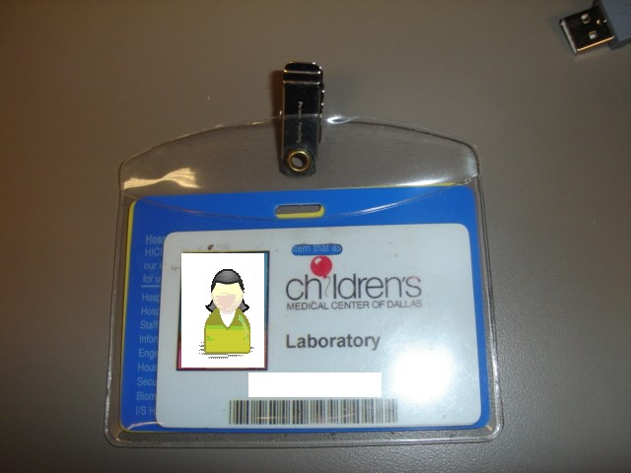
During your time with us
You will be given a badge to wear above the waist, with the picture forward, at all times while you are on campus.
  The badge identifies you
  The badge allows you access to the parking area
  The badge allows you access to the lab
  The badge gives you discounts in the cafeteria.
Jane Doe

Slide 8
What to wear
You may wear scrubs of any color
Excessive use of perfume or cologne is not allowed
You may wear street clothes; however:
  You may not wear:
    Blue Jeans or pants of jean material
    T-shirts or sweatshirts bearing any message or name are not allowed.
    Open toe shoes, flip flops/sandals, crocs with holes or open in the back, or high heels
    Excessive jewelry should not be worn. Facial jewelry is limited to earrings
    Tattoos should be covered
    Clothing that is too short, too tight or too revealing will not be permitted.

Slide 9
While in the Lab
You must wear disposable lab coats, buttoned up the front
You must adhere to safety requirements of each individual department
You must not wear lab coats outside of the laboratory or in clean area’s of the lab.
You may not listen to I Pods or use cell phones. If you must take or make a call, clear this with your preceptor and step outside of the lab.
You may not use the computers for personal use
You may only read approved school or lab material with permission from preceptor

Slide 10
Tardiness or Absences
Notify trainer/sponsor/senior tech/supervisor
  before you leave the department,
  if you will be late or leaving early
  or if you are not coming in at all.
Notify them before your shift begins
Contact the Lab Education department
Contact the trainer or supervisor of the area your are rotating through
You must make up any time missed

Slide 11
Each department is different
Please be aware that requirements, start time, training, and lay outs of each department may be different from each other.
Please go over any requirements the first day with you assigned trainer/sponsor/senior tech/supervisor

Slide 12
We look forward to meeting you!
We looking forward to your time with us and hope to make it educational and enjoyable.
If we can assist you in your success while you are with us, please don’t hesitate to ask.

Slide 13
Contact Information
Lena M. Pate MT AHI (AMT)
  Lab Education Coordinator
  lena.pate@childrens.com
  Phone: 214-456-5076
  Fax Number: 214-456-5174

