Slide 1
TCHATT Onboarding

Slide 2
Objectives
Learn about the TCHATT Program
Understand your role in the TCHATT Process
Learn how to make a referral to TCHATT

Slide 3
What is TCHATT?
Texas Child Health Access Through Telemedicine (TCHATT)
State-Funded (no cost) virtual behavioral health program for identifying and assessing mental health needs
Provides access to mental health care services for your students via Zoom
Services may include therapy, psychiatry, and/or case management support

Slide 4
What is the Goal of TCHATT?
To catch common concerns early before they develop into larger mental and behavioral health concerns
To address common barriers to accessing mental health care
To provide short-term intervention; our clinicians assess the need for ongoing mental health services and facilitate access to community resources through case management support

Slide 5
Who Are We?
TCHATT is a partnership between UT Southwestern and Children’s Health
Our team is comprised of:
TCHATT Clinicians (LCSW/LMSW, LPC/LPC-A, PsyD)
Therapists who provide treatment to your students via Zoom
Case Managers (CMs)
Care Coordinators who assist with resource connection
Care Assistants (CAs)
First point of contact for registration calls and administrative support
Consulting Child and Adolescent Psychiatrists (CAPs)
Provide psychiatric consultation
Outreach Coordinators (OCs)
Engage in outreach and relationship building in the field
Provide Trayt and other technical assistance

Slide 6
Services Provided by TCHATT
Initial informational telephone call with Care Assistant to schedule the virtual intake
90-minute virtual intake with the clinician; parent/guardian and student from the same place (preferably at home)
Intake determines the most appropriate services for your student
Short-term Virtual Therapy
Case Management
Psychiatric Consult
45-minute short-term, virtual therapy sessions conducted at school via Zoom. Parents are encouraged to join at the last 10 minutes of the session.
When more specialized or long-term therapy is appropriate, our case managers can provide resource and referral support.
When a student’s presentation appears clinically complex. The caregiver and student both need to be present. This consult takes place via zoom during the school day.

Slide 7
What is the Referral Process?
Anyone can identify a student who could benefit from TCHATT
School counselor discusses program with family, gives them the online link to consent forms or print out paper copies and have them sign
Online or Paper
If family completes online consents, those will come directly to us. Remind family that they will need to verify their email with online consents.
Sign into Trayt and submit the referral
Paper copies of consents can be attached to the student’s referral in Trayt
Care Assistant outreaches family to conduct an information gathering phone call and schedule an intake with therapist
Therapist conducts virtual intake with parent/guardian and student and provides recommendation for next steps
School counselors will receive communication after the intake regarding the outcome and next steps

Slide 8
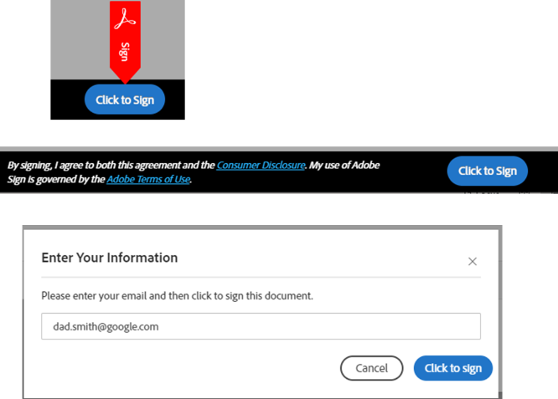
TCHATT Consent Forms
The consent forms package consists of 7 pages
Children's Health/UTSW are healthcare institutions which require all consent forms to be completed prior to scheduling the intake appointment
Parent/Guardian will be prompted to enter their email address when completing the online consent forms. They will receive an email from Adobe asking them to verify their email address.
New consent forms are required for all 2024-2025 TCHATT referrals
The most recent consent forms, links, and additional information about the consent forms can be found on the Hidden Page

Slide 9
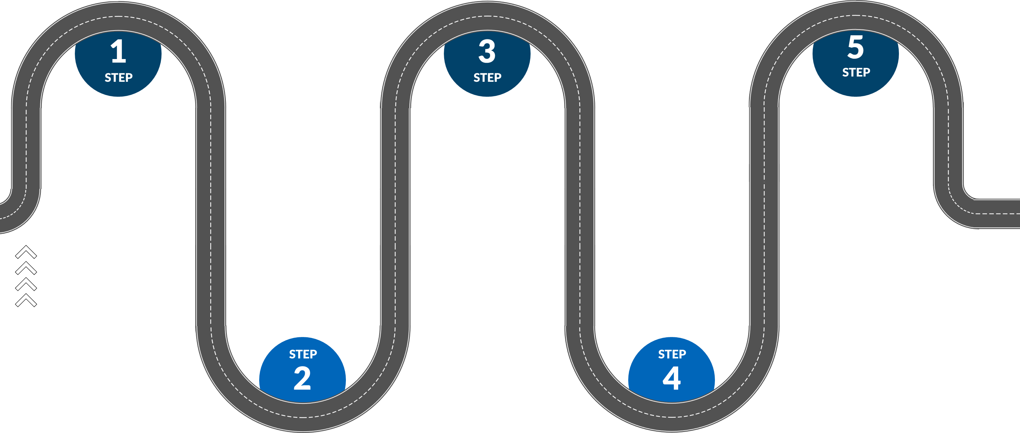
TCHATT Referral Roadmap
DISCUSS
Discuss program with family and give consents to fill out. Online and printable consents can be found on the Hidden Page
TRAYT
Complete and submit your referral into Trayt
OUTREACH
A TCHATT Care Assistant will reach out to the family to schedule intake
INTAKE
Family will complete intake with TCHATT Clinician to determine next steps
NEXT STEPS
TCHATT Clinician will reach out to you regarding next steps.
Potential next steps may include any or all:
• Psychiatry Consult
• Case Management
• Short-Term Therapy

Slide 10
Callie’s* TCHATT Course (Short-Term Therapy) *not a real student
Callie is a 14-year-old Asian female who has dealt with chronic bullying and has faced some family conflict in the home. She struggles with reporting the bullying incidents at school, and instead isolates and withdraws. A couple of years ago, this led to a period when she engaged in self-harm. At that time, Callie went to counseling and things improved. Recently, the family has faced some financial struggles and increased conflict, but Callie is unable to go back to the counselor she went to before. Callie would benefit from tools to be able to advocate for herself and increase her self-esteem.
Intake
• In-depth assessment
• Determine next steps
Case Management
• Resource
coordination
matching the students' needs and concerns
Therapy
• Virtual short-term therapy sessions at school
Registration Call
• Confirm interest
• Schedule intake

Slide 11
Jose’s* TCHATT Course (Case Management Support) *not a real student
Jose is a 15-year-old Hispanic male who lives at home with both parents and younger siblings. Jose is uninsured and has been referred for failing grades. School counselor spoke with Jose who stated he has been hearing voices that tell him to harm others. Jose’s parents report he has not been seen by a primary care provider for three years, he does report hearing voices to them, but they help him cope with prayer. There are no behavioral concerns and family is not aware of what options are available to assist with barriers for care and would like to help Jose with his overall functioning.
Case Management​
Continued
• Follow up to ensure family is connected to appropriate resources
Intake
• In-depth assessment
• Determine next steps
Registration Call
• Confirm interest
• Schedule intake
Case Management
• Resource
coordination
matching the students' needs and concerns

Slide 12
What mental health or behavioral concerns do you see as counselors in your schools?

Slide 13
Common Signs-Symptoms
Elementary School
Middle School
High School
Misbehavior
Somatic symptoms
Increased fears
Parenting support
Bullying concerns
Peer concerns
Change in activities
Change in eating/sleeping
Increased worrying
Peer concerns
Change in eating/sleeping
Change in activities
Persistent sadness
Anhedonia
Worry or anxiety
Can receive referrals for students 4+
Adult students can sign their own consents

Slide 14
TCHATT Does NOT Provide
Immediate crisis response
Psychological testing
Neuropsychological testing
Court ordered/mandated therapy
Custody dispute support
Duplication of services

Slide 15
Crisis Response in Sessions
It is the expectation of TCHATT that you use your school's crisis response protocol, as mandated by law, when a student is in active crisis, or when notified by a Children’s Health staff member of a student in crisis
If during a therapy session, the student indicates thoughts about harming themselves or someone else, or if they indicate they are in a dangerous situation:
The clinician will assess the threat of harm
If the student has immediate risk for suicide or self-harm, the clinician will notify the school contact to initiate a safety plan and take over the session
Once the student is safe, the clinician will contact the parent/guardian
Once a student has been in active crisis while meeting with a TCHATT clinician, the student will then be referred for a supportive higher level of care (ex: the emergency room, inpatient, IOP, etc.) and it is expected that the student follow the discharge plan accordingly

Slide 16
TCHATT Case Consultation
Request
If you have questions or concerns if TCHATT is right for a particular student, you can complete this form and receive a call within 2 business days from a TCHATT leader for case consultation.
Form is found on the Hidden Counselor Page under “TCHATT Consultation Request”

Slide 17
Expectations for School Staff
Availability for communication during active crisis for crisis response
Assisting students in attending therapy sessions on time
Advanced communication of students scheduling concerns/changes
Providing a private space for students to meet for therapy sessions
Have tablet charged and ready (if applicable)
Ensuring a stable internet connection
If using paper consents, ensuring ROI is completed with school information
** AFTER 2 NO SHOW SESSIONS STUDENTS WILL RECEIVE RESOURCES FOR COMMUNITY PROVIDERS**
*No show= not attending and no communication*

Slide 18
Trayt Demo
Watch it:
Trayt School Portal Video
Practice it:
https://staging.tchattschools.trayt.health
traytschoolportal+utsw@gmail.com Trayt@123

