Slide 1
Online Portal for completing consents: - School Referrals Package - Treatment Package
Funded and administrated by the Texas Child Mental Health Care Consortium

Slide 2
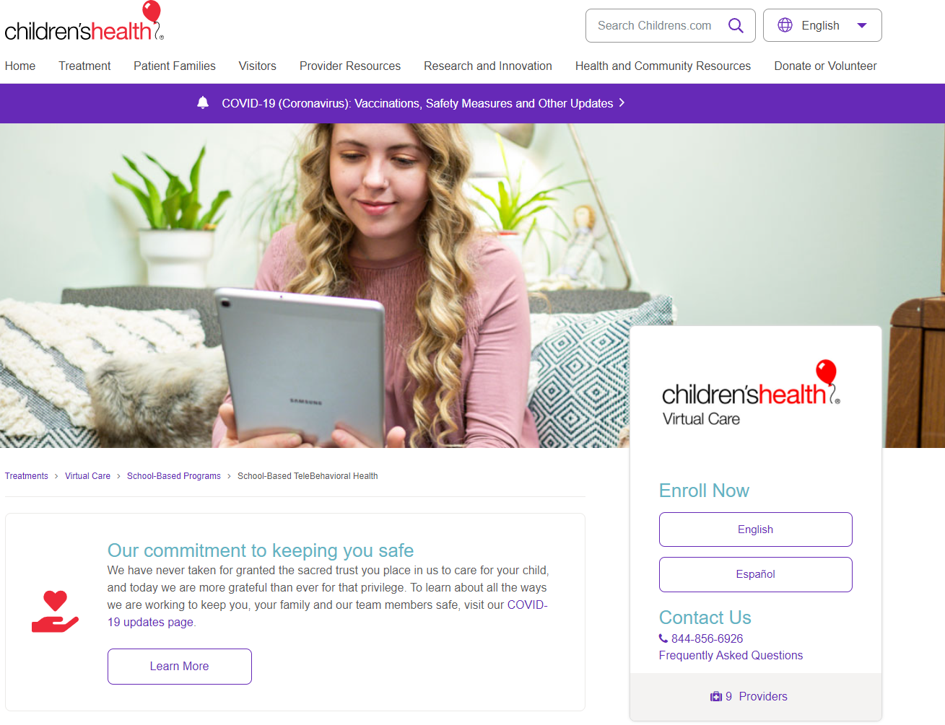
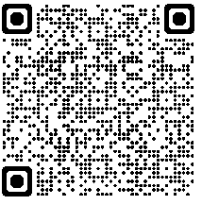
childrens.com/telebehavioral
Direct caregivers to this site, or share the QR Code, to get them started.
They can select one of two languages in the Enroll Now box.
Phone number is listed if they have any questions not answered in the FAQ.

Slide 3
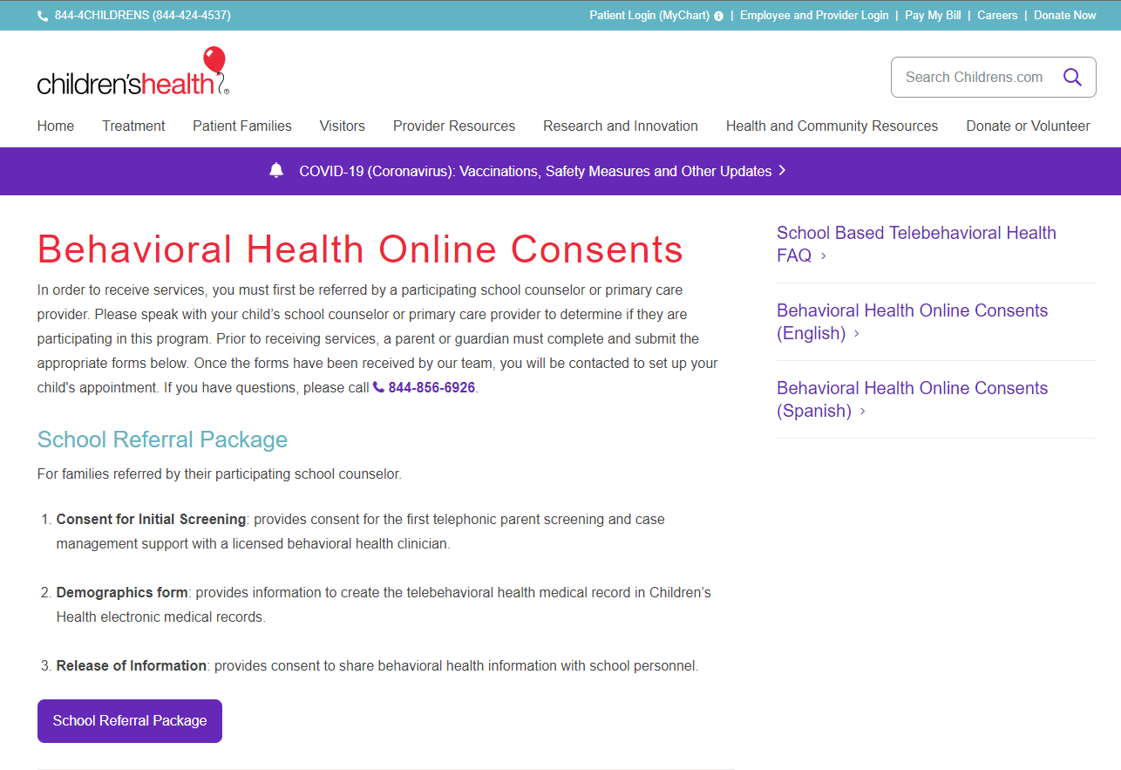
School Referral Package
When caregivers select School Referrals Package they will be linked to online Consent, Demographics, and ROI forms.

Slide 4
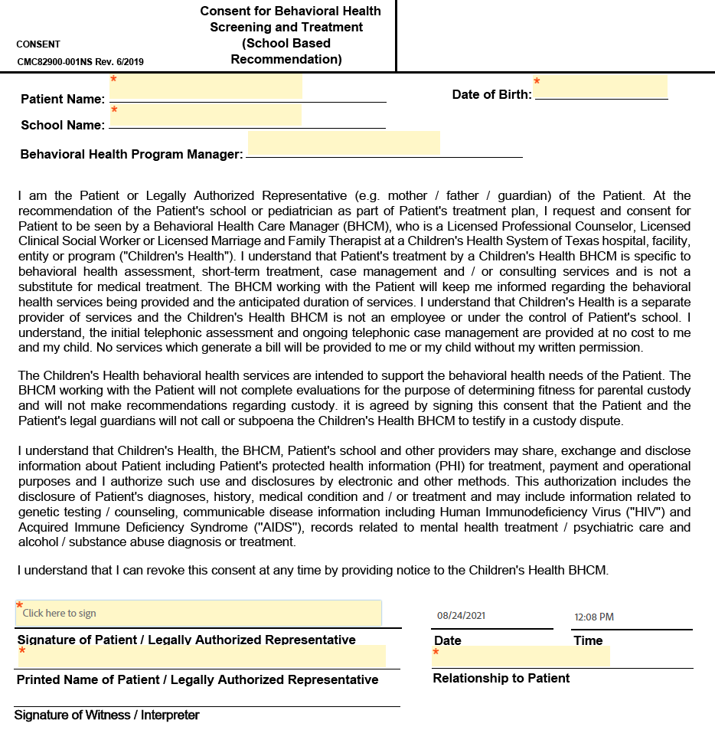
Consent Form
Only areas with the red asterisk (*) need to be completed.

Slide 5
Demographics Form
As with the previous form, only areas with the red asterisk (*) need to be completed.
No Social Security or insurance information is necessary for this program.

Slide 6
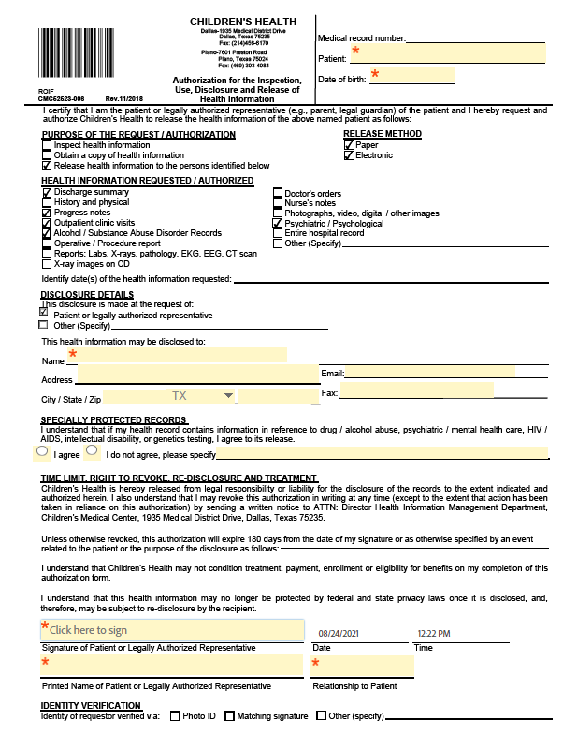
ROI Form
As with the previous forms, only areas with the red asterisk (*) need to be completed.
Disclosure Details – Name is the campus at which the student attends so the TCHATT BHCM can share information with the counselor and/or school clinician.

Slide 7
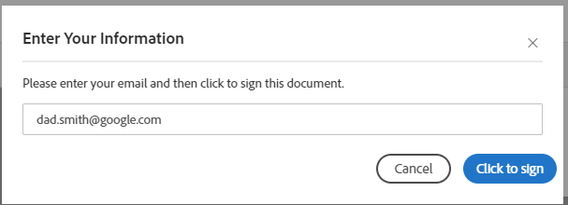
Signing the Forms
Once complete, Click to Sign will be visible at the bottom of the page.
When clicked, the caregiver will be asked for their email.
Caregiver will have to verify their email address in an email from Adobe.
Consent forms have been received, caregiver has been notified of receipt, treatment will begin with scheduling of the assessment.

Slide 8
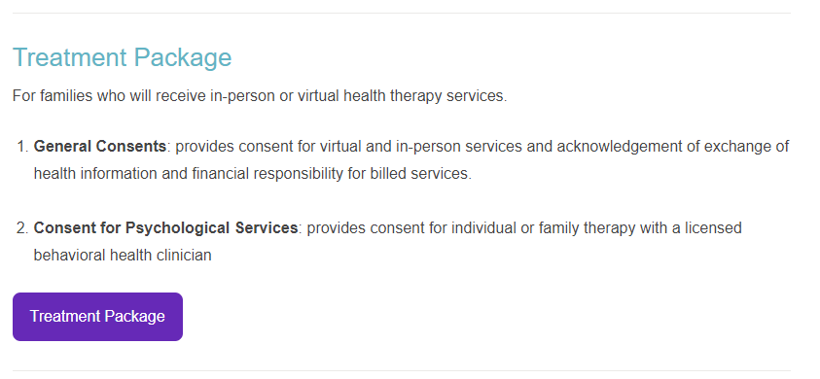
Treatment Package
Next, caregivers select Treatment Package where they will be linked to online General Consent for Treatment and Acknowledgements (3 pages) and Therapy Consent.

Slide 9
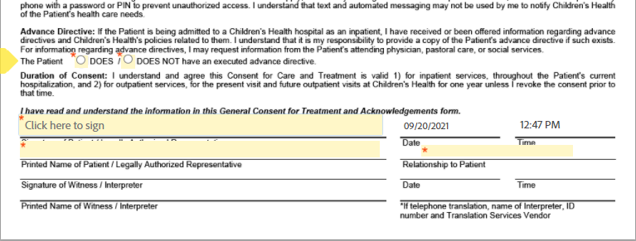
General Consent
As with the previous forms, only areas with the red asterisk (*) need to be completed and select correct radio button.
This is not the whole document – This is the top of page 1 and the area that needs to be completed.

Slide 10
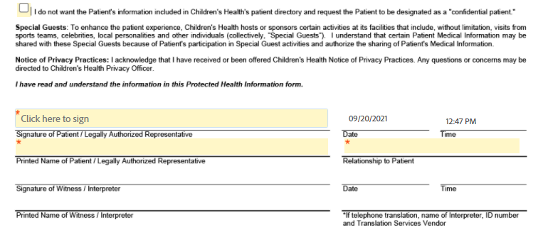
Protected Health Information (PHI)
As with the previous forms, only areas with the red asterisk (*) need to be completed and box checked if the caregiver wishes anonymity for their student.
This is not the whole document – This is the top of page 2 and the area that needs to be completed.

Slide 11
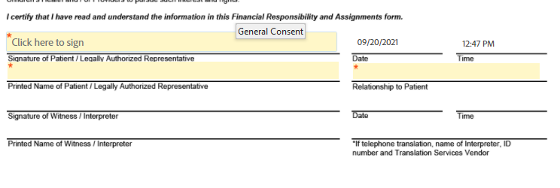
Financial Responsibility
As with the previous forms, only areas with the red asterisk (*) need to be completed and radio button selected if the caregiver knows if their insurance is in-network at Children’s.
This is not the whole document – This is the top of page 3 and the areas that needs to be completed.
As a reminder – TCHATT is of no cost to families or schools. We collect this information for statistical purposes ONLY.

Slide 12
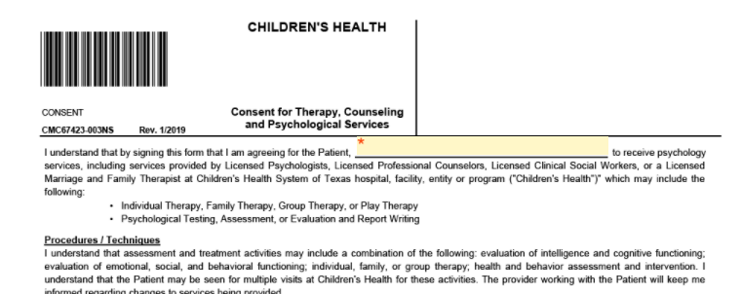
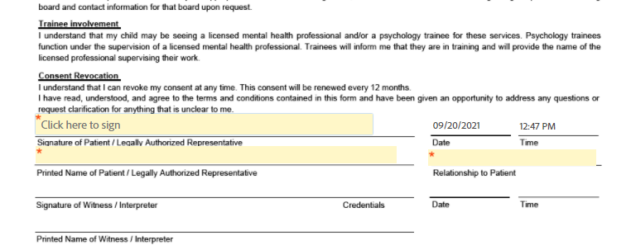
Therapy Consent
As with the previous forms, only areas with the red asterisk (*) need to be completed.
This is not the whole document – This is the top of page 4 and the areas that needs to be completed.

Slide 13
Signing the Forms
As before, once complete, Click to Sign will be visible at the bottom of the page.
When clicked, the caregiver will be asked for their email.
Caregiver will again have to verify their email address in an email from Adobe.
Treatment forms have been received, caregiver has been notified of receipt, treatment will begin with scheduling of the assessment.

